Slide 1
Capstone Project
Hotel Booking Analysis

Slide 2
Capstone Project Submission
Instructions:
i) Please fill in all the required information.
ii) Avoid grammatical errors.
Team Member’s Name, Email and Contribution:
1. Sonkar Abhishek ( Team Leader ) 2. Gourav Patil 3. Akshay Pawar 4. Ritesh Neulkar 5. Kevin Varsani
Github Link:- https://github.com/abhi14062000/hotel-booking-analysis.git
To discuss the analysis of given hotel bookings data set from 2015-2017.
NO | NAME | EMAIL ID | CONTRIBUTION
1 | SONKAR ABHISHEK | sonkarabhi1406@gmail.com | PREPARED THE PYTHON PROJECT
2 | GOURAV PATIL | patilgourav84@gmail.com | HELPED WITH ANALYSIS
3 | AKSHAY PAWAR | akshaypawar459@gmail.com | HELPED WITH ANALYSIS AND DETAILS
4 | RITESH NEULKAR | riteshneulkar@gmail.com | HELPED WITH ANALYSIS AND PPT
5 | KEVIN VARSANI | varsanikevin@gmail.com | HELPED WITH ANALYSIS AND TECHNICAL DOC.

Slide 3
POINTS TO DISCUSS :
Introduction To EDA
Abstract
Agenda
Data Summary
Cancelled Booking Analysis
Hotelwise Analysis
Agent Analysis
Reservation Analysis
Timewise Analysis
Conclusion

Slide 4
What is EDA ?
Exploratory Data Analysis (EDA)
IS
AN
approach to analyze the data using visual techniques. It is used to discover trends, patterns, or to check assumptions with the help of statistical summary and graphical representations.

Slide 5
ABSTRACT :
Have you ever wondered when the best time of year to book a hotel room is? Or the optimal length of stay in order to get the best daily rate? What if you wanted to predict whether or not a hotel was likely to receive a disproportionately high number of special requests?
This hotel booking dataset can help you explore those questions!
The analysis tries to answer three questions:
How strong is the seasonality in these hotels?
At what time in week the hotels are more busy ?
Can we predict a cancellation, just with the information available at the moment this reservation has been made?

Slide 6
Maximize Insight Into A Dataset
Uncover Underlying Structure
Extract Important Variables
Test Underlying Assumptions
Determine Optimal Factor Settings (Xs)
AIMS TO THE EDA
Develop Valid Models
Detect Outliers And Anomalies

Slide 7
AGENDA
To discuss the analysis of given hotel bookings data set from 2015-2017.
We’ll be doing analysis of given data set in following ways :
Cancelled Booking Analysis
Hotelwise Analysis
Agent Analysis
Reservation Analysis
Timewise Analysis
Week Stay Analysis

Slide 8
Data Summary :
Given data set has different columns of variables crucial for hotel bookings. Some of them are:
hotel: The category of hotels, which are two resort hotel and city hotel.
is_cancelled : The value of column show the cancellation type. If the booking was cancelled or not. Values[0,1], where 0 indicates not cancelled.
lead_time : The time between reservation and actual arrival.
stayed_in_weekend_nights: The number of weekend nights stay per reservation
stayed_in_weekday_nights: The number of weekday nights stay per reservation.
meal: Meal preferences per reservation.[BB,FB,HB,SC,Undefined]
Country: The origin country of guest.

Slide 9
Data Summary (contd..)
market_segment: This column show how reservation was made and what is the purpose of reservation. Eg, corporate means corporate trip, TA for travel agency.
distribution_channel: The medium through booking was made.[Direct,Corporate,TA/TO,undefined,GDS.]
Is_repeated_guest: Shows if the guest is who has arrived earlier or not.Values[0,1]-->0 indicates no and 1 indicated yes person is repeated guest.
days_in_waiting_list: Number of days between actual booking and transact.
customer_type: Type of customers( Transient, group, etc.)

Slide 10
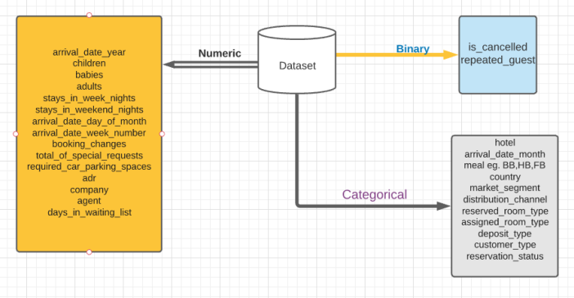
Data Summary :

Slide 11
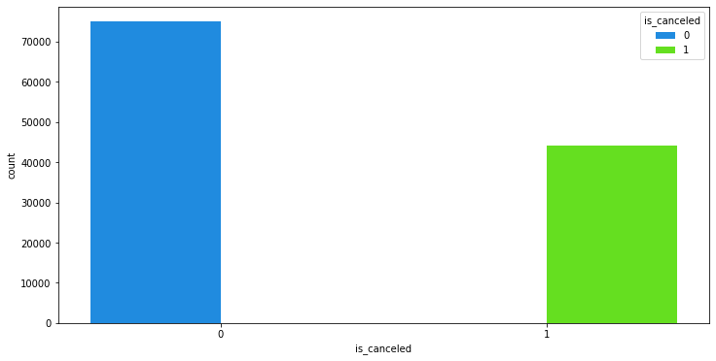
Cancelled Booking Analysis :
So here we can see that almost 37% times the bookings got cancelled

Slide 12
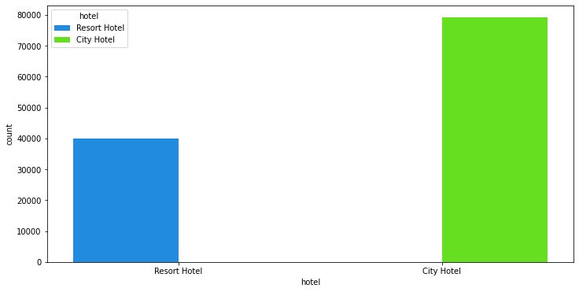
Hotelwise Analysis :
From the following graph we can see that more than 60% peoples prefer city hotels

Slide 13
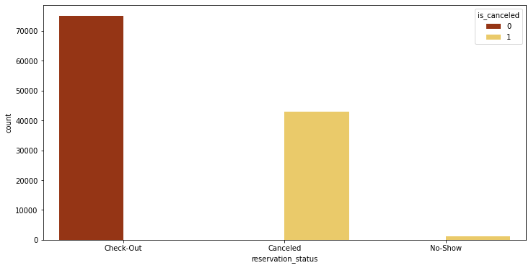
Reservation Analysis :
In the below graph, we can see almost 40% is in cancel reservation

Slide 14
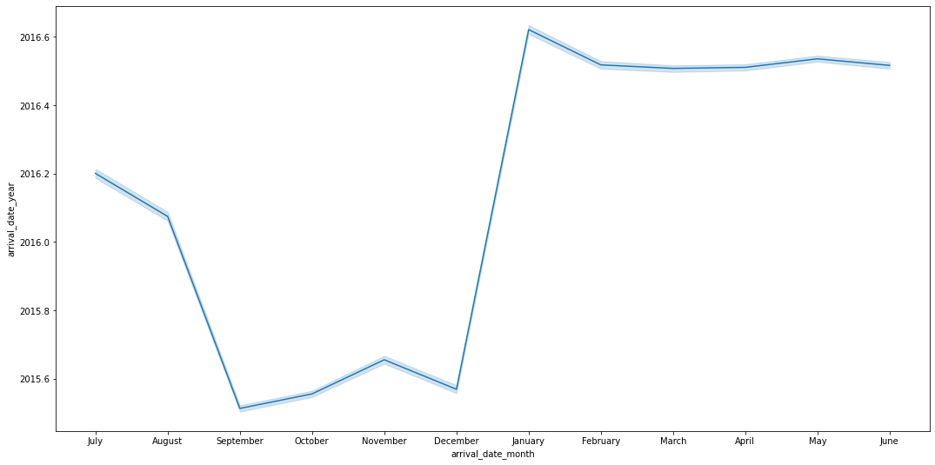
Timewise Analysis :
From the month of July to August the number of bookings increased and in August, City Hotel got most number of guests.

Slide 15
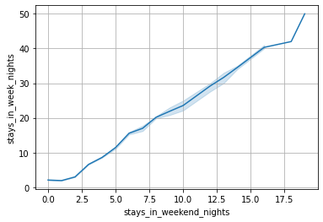
Timewise Analysis(contd..)
So here we can see that stays in week nights is more than weekend nights

Slide 16
Conclusion :
Around 60% bookings are for City hotel and 40% bookings are for Resort hotel, therefore City Hotel is busier than Resort hotel.
Both hotels have significantly higher booking cancellation rates
July- August are the most busier and profitable months for both of hotels.
Stays in week nights is more than weekend nights.
Almost 40% is in cancel reservation.

